Slide 1
Updates on the Management of Pelvic Organ Prolapse
Rahel Nardos, MD, MCR.
Female Pelvic Medicine and Reconstructive Surgery
Director of Global Women’s Health
Center for Global Health and Social Responsibility
University of Minnesota

Slide 2
Disclosure
None

Slide 3
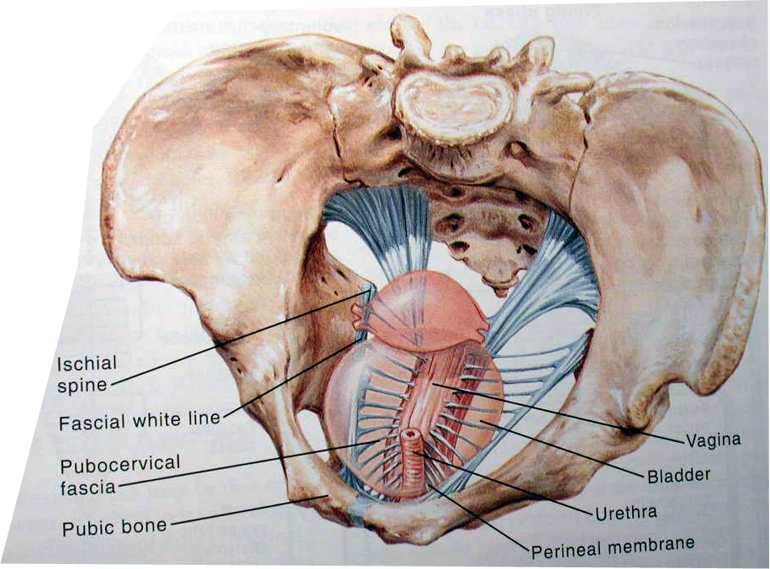
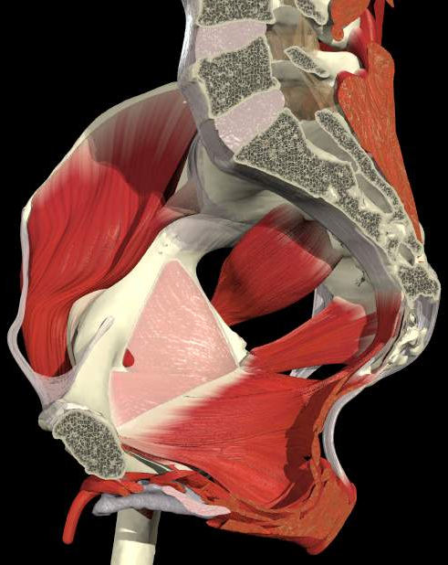
Pelvic Support
Apical support (Level I support)
Lateral support (Level II support)
Distal support ( Level III support)
Coccygeus
Levator Ani
Arcus Tendineus Fascia Pelvis
Notes:
The pelvic floor is made up of the pelvic floor muscles and connective tissue work together support the contents of the pelvis such as bladder, uterus and intestines.
The levator ani muscles keep the pelvic floor closed and provide a lift to prevent pelvic floor descent. So when there is injury to these muscles that disrupts or weakens them, for example ( childbirth), there is more opening in the pelvic floor ( which we call larger levator hiatus ) leading to protrusion of various components of the vaginal wall. This protrusion creates a pressure differential leading to more abdominal pressure pushing against the connective tissue that attach the pelvic organs like uterus and vagina to the pelvic side walls. This leads to further relaxation of these support structures allowing the pelvic organs to descend further.
We talk about pelvic floor support
In Level I, the cervix and upper third of the vagina are attached to the pelvic walls by mesenteric structures that suspend these organs (cardinal and uterosacral ligaments)
In Level II the middle third of the vagina it is attached laterally to fascial structures (arcus tendineus fascia pelvis)
Level III, the vagina is fused with the surrounding structures, namely the levator ani muscles and the perineal body.

Slide 4
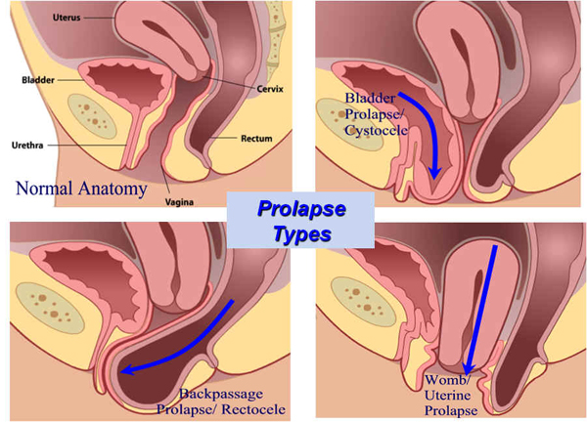
Don’t ignore the APEX!
Advanced anterior wall prolapse is highly correlated with apical Prolapse ¹
Reoperation rates for prolapse recurrence is almost doubled when apical compartment is not addressed at the time of repair ²
Rooney, K., et al, Am J Obstet Gynecol, 2006
Eilber, K.S., et al, Obstet Gynecol, 2013
Notes:
Important to address the apical component at the time of prolapse repair

Slide 5
Treatment Choices for Pelvic Organ Prolapse
Prolapse
Conservative Management
Observation
PT
Pessary
Surgery
(+/- Hysterectomy)
Vaginal
Abdominal
Mesh
NonMesh
Mesh
Laparoscopic
Mesh
Open
#1
?
?
Caution
#2

Slide 6
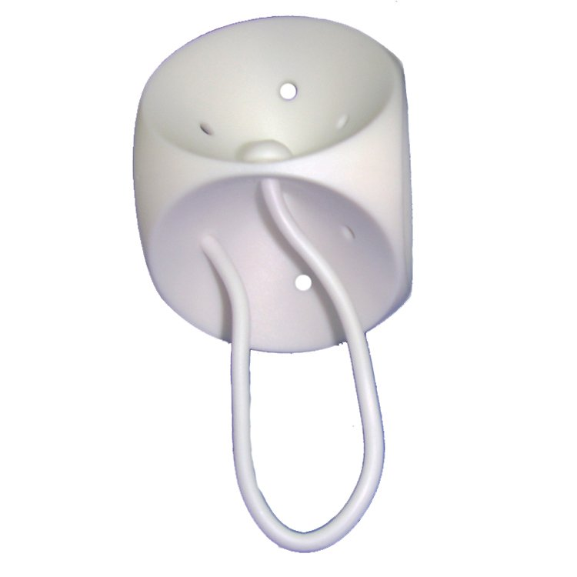
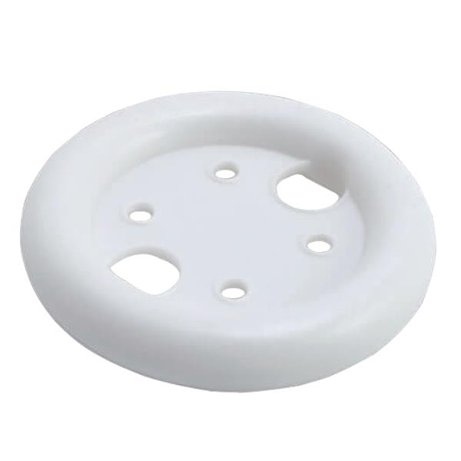
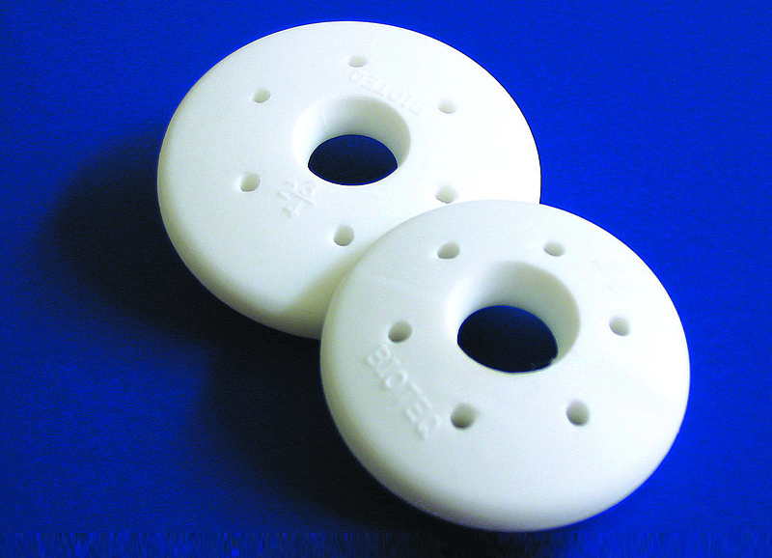
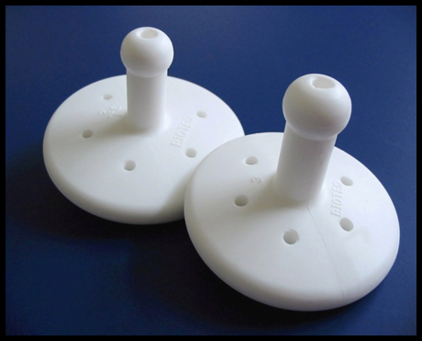
Indication for Pessary
POP/SUI
Preference for non-surgical tx
Not surgical candidate
Co-morbidities
Need to delay surgery
Recurrence
Pregnancy/Future fertility
Cube
Ring with Support
Shaatz
Gelhorn

Slide 7
Relative Contraindication for Pessary
Severe untreated vaginal atrophy
Vaginal bleeding of unknown origin
Pelvic inflammatory disease
Abnormal pap smear
Expected non-compliance with follow-up

Slide 8
Pelvic Floor Physical Therapy (PFPT)
May incorporate Pelvic muscle strengthening, relaxation and coordination
May involve manual therapy, biofeedback, behavioral education and home exercise programs
Pelvic Organ Prolapse Physiotherapy trial ¹
Multicenter RCT at 23 centers
Symptomatic Stage I, II or II Prolapse randomized to PFPT vs lifestyle advise on pamphlets
Women in PFPT group had significant reduction in POP symptom scores 1-year out
More women in control group received further treatment with in 1-year
Meta Analysis of 13 RCTs ²
Greater improvement in objective POP stage (risk ratio of 1.7) with PFPT
More women with PFPT reported improvement of POP symptoms (risk ratio of 5.48)
2013 International Consultation on Incontinence: Level I evidence to recommend PFPT for POP ³
Hagen S et al. Individualised pelvic floor muscle training in women with pelvic organ prolapse (POPPY): a multicentre randomised controlled trial. Lancet 2014;
Li C et al. The efficacy of pelvic floor muscle training for pelvic organ prolapse: a systematic review and meta-analysis. Int Urogynecol J 2016
Dumoulin C et al. Conservative management for female urinary incontinence and pelvic organ prolapse review 2013: summary of the 5th International Consultation on Incontinence. Neurourol Urodyn 2016

Slide 9
Types of Native Tissue Vaginal Apical Repairs
Uterosacral Ligament Suspension
High
Low (McCall and modifications)
Sacrospinous Ligament Suspension
Posterior
Apical-Michigan 4-corner
Obliterative procedures
Colpocleisis
Notes:
Michigan four corner: All four vaginal walls are directly approximated to the sacrospinous ligament (instead of only the posterior vaginal wall) . The sutures are placed through the sacrospinous ligament, then incorporated to both anterior and posterior apex, and tied to the ligament

Slide 10
Vaginal Non-Mesh Uterosacral ligament suspension
Intraperitoneal
Delayed absorbable sutures /Permanent sutures
Miya/ Capio
Proximity to ureters (upto 11%)
ureter
USL
Notes:
So here you can see in the left image the uterosacral ligament sutures placed bilaterally . These sutures are generally placed at the level of the ischial spine. One of the risks with this procedure is ureteric injury as the ureters course very close to the uterosacral ligament as you can see in the bottom picture. When I do these procedures , I usually put the sutures in after I palpated and visualized the uterosacral ligaments and then I perform cystoscopy with and without tension on the sutures to make sure I see robust ureteric efflux and there is no obstruction . After I attach these sutures to the vaginal cuff and tie, I repeat another cystoscopy to make sure that tying the suture did not cause any kinking of the ureters. I will never do this procedure if I don’t have a good working cystoscope for this reason.

Slide 11
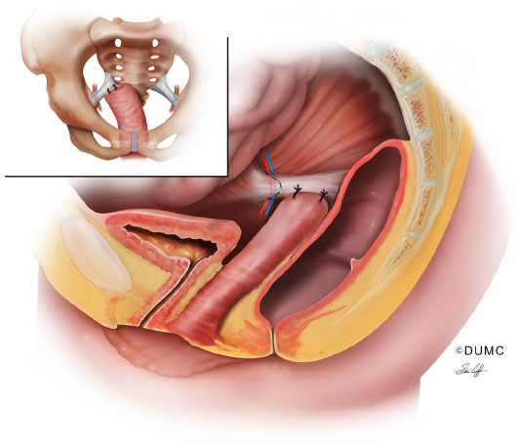
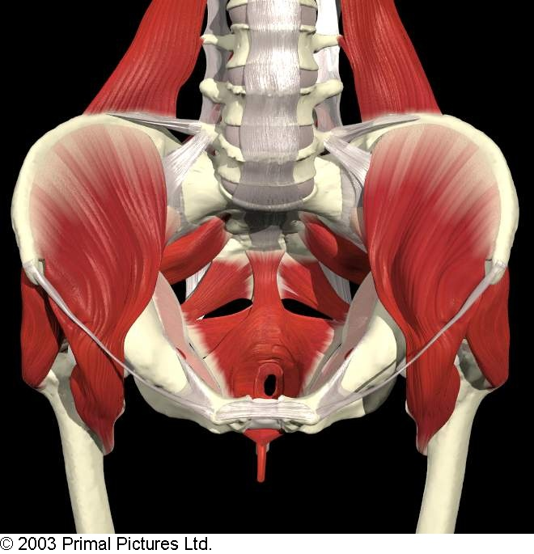
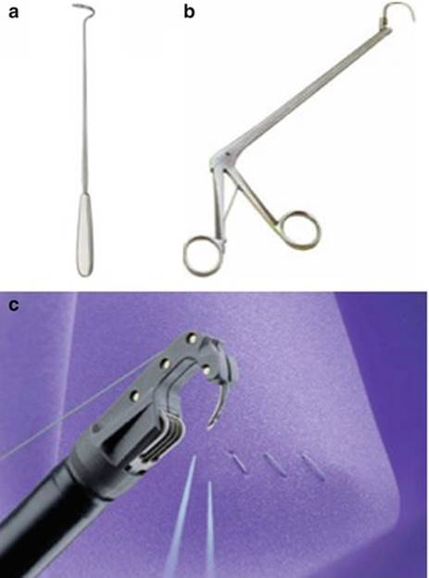
Sacrospinous Ligament Fixation
Notes:
Sacrospinous ligament suspension is usually done along the patients right sacrospinous ligament, which lies underneath the coccygeus muscles. We use the capio suture suspension devise in the US. In Ethiopia, we have used miya . Bilateral SSLS is also possible with a long vagina

Slide 12
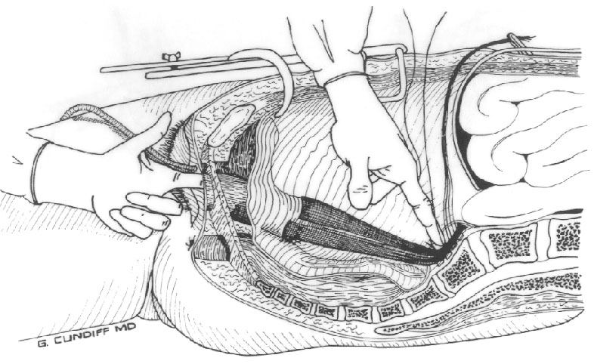
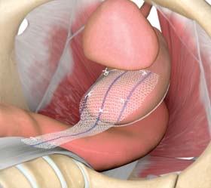
Sacrocolpopexy
Polypropelene Monofilament Macroporous Mesh
Delayed absorbable sutures to attach mesh to vagina
Open or minimally invasive

Slide 13
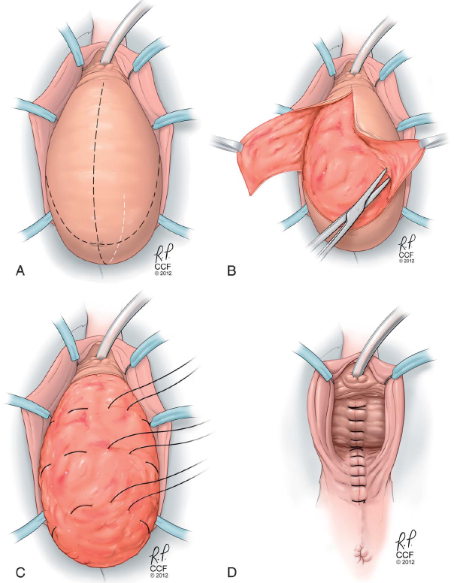
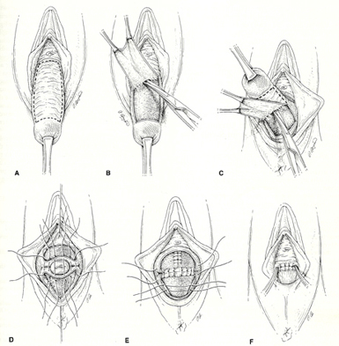
Colpocleisis (Obliterative Procedure)

Slide 14
Surgical outcomes: Vaginal vs Open Abdominal SCP
Cochrane Meta-Analysis ( Maher et al, 2013)
Abdominal sacral colpopexy was associated with a lower rate of recurrent vault prolapse and less dyspareunia than vaginal sacrospinous colpopexy.
In single studies the sacral colpopexy had a higher objective success rate and lower reoperation rate as compared to vaginal uterosacral ligament suspension
The abdominal sacral colpopexy had a longer operating time, longer recovery time and higher cost than the vaginal surgery.
Open Abd SCP had higher rates of ileus, small bowel obstruction and mesh and suture complications
Data on the subjective success rate, patient satisfaction and impact of the surgery on quality of life were too few for reliable conclusions
Single studies have shown equivalent subjective success rates
Maher Cet. al.: Surgical management of pelvic organ prolapse in women. Cochrane Database Syst Rev 2013; CD004014
Notes:
In general, abdominal SCP is considered the gold standard procedure in the treatment of apical POP with success rates ranging from 58% to 100%,

Slide 15
Vaginal vs. Abdominal
Vaginal Procedure:
Most commonly performed procedure
Vaginal: 80-90% vs. Abdominal: 10-20%¹⁻⁴
Preferred especially in older women
Shorter operation
Easier to perform concomitant A&P and incontinence procedure
Fewer adverse events (vs. laparotomy)
Lower Cost (population aging/increase in surgery)
1. US FDA, 2014
2.Brown et al, 2002
3.Olsen et al, 1997
4.Boyles et al, 2003

Slide 16
Mekelle Data 2018
Stage 3 or 4 POP Repair Outcome ( 2018, Hamlin Fistula Mekelle)
 | Traditional (TVH/AC, N=40) | Apical suspension (TVH/SSLS, N=40)
Age | 47.8 (SD 12.1) | 54.1 (SD 9.4) | 0.01
Number of Pregnancies | 4.7 (SD 2.0) | 5.8 (SD 2.4) | 0.03
Subjective Cure | 80% | 97.5% | 0.01
Satisfaction | 72.5% | 87.5 | 0.20
Reoperation | 17.5% | 5% | 0.08
Bulge symptoms | 47.5% (84% POP III or IV) | 20% (43% POP III or IV) | 0.01

Slide 17
Laparascopic SCP vs Open
Compared with minimally invasive SCP, open SCP was associated with ^{1,2}
higher rates of complications (7.6% vs 5.1%)
longer duration of hospitalization
shorter operative time
higher rate of perioperative blood transfusion and blood loss
higher rate of 30-day hospital readmission,
Higher rates of 30-day reoperation
Equivalent surgical outcomes ³
1.Nosti P.A et. al.: Outcomes of abdominal and minimally invasive sacrocolpopexy: a retrospective cohort study. Female Pelvic Med Reconstr Surg 2014
2.Linder B.J., Occhino J.A., Habermann E.B., et. al.: A national contemporary analysis of perioperative outcomes for open versus minimally-invasive sacrocolpopexy. J Urol 2018
3. Freeman R.M et. al.: A randomised controlled trial of abdominal versus laparoscopic sacrocolpopexy for the treatment of post-hysterectomy vaginal vault prolapse: LAS study. Int Urogynecol J 2013;

Slide 18
Abdominal sacrohysteropexy vs Hysterectomy with sacrocolpopexy
Prospective case series
Costantini et al (2013)
-72 pts with St 3-4 UVP
-shorter operative time (89m vs 115 m)
-less EBL (200ml vs 325 ml)
-shorter hospital stay
-similar objective and subjective outcome (51 mo)
Hysteropexy Success :
-91-95% objective
-77-88% subjective
Limitation: Short term outcomes

Slide 19
Does Sacrocolpopexy address posterior compartment?
Extended CARE Trial
5 year follow-up
96% of women with Apical and posterior prolapse had resolution of posterior prolapse with SCP alone
No further surgery for posterior compartment
Ercoli A et. al.: Anatomical insights into sacrocolpopexy for multicompartment pelvic organ prolapse , Neurourol Urodyn 2016

Slide 20
Sacrocolpopexy and Mesh Complications
Mesh erosion ranges from 2-10%.
CARE trial, 7 year follow up . Mesh erosion risk of 10%. 65% required excision (1)
Risks include Concurrent Hysterectomy, Mesh Type, Hx of Smoking and Placement of SCP mesh vaginally
Nygaard I et. al.: Long-term outcomes following abdominal sacrocolpopexy for pelvic organ prolapse. JAMA 2013

Slide 21
Mesh vs autologous fascia in Sacrocolpopexy
Randomized study: Cadaveric fascia lata vs polypropylene mesh
Objective cure rates significantly higher in the mesh group vs fascial group ((91%) vs 68%; P = .007) at 1-year follow-up.
Mesh group had higher rates of graft-related complications (26% vs 15%)
erosions, wound breakdown, postoperative fever, or ileus
Culligan P.Jet. al.: A randomized controlled trial comparing fascia lata and synthetic mesh for sacral colpopexy. Obstet Gynecol 2005

Slide 22
Colpocleisis Outcome
Elderly patient, no longer sexually active
Success = 90-100%
Regret = 0-13%
Postoperative morbidity & mortality:
5% cardiac, thromboembolic, pulmonary and cerebrovascular events
15% minor morbidity
Mortality 1/400
90% with elevated PVRs will have resolution after surgery
33% risk of de novo stress urinary incontinence
Abbasy, et al. Clin Obstet & Gynecol, 2010
Smith, et al. Int Urogynecol J, 2011
Koski, et al. J Uro, 2012
Notes:
Regret is NOT related to age (unlike tubals)
Often post operative complications are linked to the fact that this procedure is often performed in patients with many co-morbidities who are at high risk for surgical complications and thus this particular procedure has been chosen to help decrease the length of the surgery, etc.

Slide 23
OPTIMAL (n=374)
Stage 2-4 prolapse
Randomization
Surgical Intervention
2 year success rate
SSLF: 63.1% vs. USLS:64.5%, aOR 1.1 (95%CI: 0.7-1.7)
(Composite outcome: anatomy + symptoms + retreatment)
SSLF n=186
USLS n=188
The OPTIMAL randomized trial. JAMA 2014
Notes:
Women with stage 2-4 prolapse were randomized to either SSLF or USLS. A composite outcome of anatomy, bulge symptom, and retreatment assessed at 2 years was similar between the two approaches.

Slide 24
Sacrospinous hysteropexy vs. High USLS
Multicenter RCT (non-inferiority, non blinded)
Netherlands ( 4 universities) ; N=208 (stage >2)
Primary outcome (composite): recurrent prolapse of stage 2 or more of apical compartment +bulge symptoms or repeat surgery
Outcome measured at 12 months
Sacrospinous hysteropexy non-inferior (0% failure) vs. Uterosacral with hysterectomy ( 4%)
Overall anatomical failure (50%vs 44%)
Detollenaer et al. BMJ 2015

Slide 25
Adverse Events
Serious adverse events:
Not significantly different (USLS 17%, vs SSLF 17%)
Neurologic pain higher in SSLF
USLS 7%, vs SSLF 12%
most resolved by 6-weeks
Ureteral obstruction (kinking)
USLS 3%* vs SSLS 0%
recognized and successfully managed intraoperatively
No difference in anterior prolapse

Slide 26
Sacrospinous Ligament suspension : Hysteropexy vs hysterectomy
70 women, prolapse to introitus
Not randomized but comparable groups
Operative time 51 min vs 91 min
Blood loss 198ml vs 402 ml
Mean f/u of 33 and 26 months, comparable subj/objective outcome
Only case reports of successful pregnancies after this procedure( Ridgway BM, 2015). No studies.
Maher et al. 2001

Slide 27
Should be remove the uterus?
Pros
Decrease uterine ca risk
Decrease cervical ca risk
Improve access to USLS
Permanent contraception
No more menses
Cons
Longer surgery
Higher surgical risks
Loss of fertility
Earlier menopause even when ovary is spared
2x as many women who had hysterectomy became menopausal during the following 4-5 yrs
In general, Uterine-preserving prolapse surgeries improve operating time, blood loss, and risk of mesh exposure and do not have inferior short-term prolapse surgery outcomes
Notes:
Even predating viral screening and modern cystology, cervical ca rate in supracervical hyst is 0.3% (storm HH,1992)
Rate of endometrial ca in women who had vaginal hyst for prolapse was 0.8% (Frick et al 2010). Post menopausal bleeding patients had as high as 13.3% endometrial pathology despite negative preoperative evaluation. No sufficient data to recommend routine screening for endometrial pathology in asymptomatic women desiring uterine sparing surgery. Using 5mm cutoff of Em lining in asymtomatic women gives only 83% sensitivity and 72% specifificty

Slide 28
Who should have hysterectomy?
Recommendation
Women with post menopausal bleeding & cervical dysplasia
No access to cervical screening
High risk HPV hx
Women with stage IV UVP (elongated vagina) or cervical elongation

Slide 29
Do we remove the cervix with Sacrocolpopexy?
188 Minimally invasive sacrocolpopexy ( 10% erosion)
Mesh Erosion risk higher with
Concurrent vaginal hysterectomy compared to vault repair ( 23% vs 5%)
Concurrent vaginal hysterectomy compared to supracervical hysterectomy ( 23% vs 5%)
Odds of erosion for vaginal hysterectomy 5.6
In General, supracervical hysterectomy unless there is concern for cervical pathology
Tan-Kim J et al. Prevalence and risk factors for mesh erosion after laparoscopic-assisted sacrocolpopexy. Int Urogynecol J. 2011

